Slide 1
What to Expect From a Penetration Test
CodeMash 2016

Slide 2




Introductions
Chris Maddalena, OSCP
@cmaddalena - IRC, GitHub, Twitter
Information Security Consultant
Penetration testing
Phishing
Security training
Co-host of the PVCSec podcast
#misec!

Slide 3

Brief Storytime
There once was a company that had a penetration test…
…and no one was really sure what to make of it.
Notes:
The point of contacts for a pen test: CISO, CTO, Director, etc.
I know web developers and they don’t get much more than bread crumbs
Last year’s pen test gave them a list of problems out of context

Slide 4

What is a Penetration Test?
Penetration tests are one form of “red teaming”.
Security professionals using tools, knowledge, and creativity to try to discover problems.
The result is a report detailing the findings from the perspective of an attacker.
Notes:
It’s like playing Devil’s Advocate
Red teaming isn’t a permanent solution
It can be demoralizing and exhausting
The goal is to aid in improving policies and processes, find problems

Slide 5




An Attacker’s Methodology
Discovery
Host hide and seek
Enumeration
Reviewing ports and services + versions
Scanning
ZAP, Nessus, Burp, dirb
Exploitation
Notes:
A very basic flow chart for a pen test

Slide 6


Similar to SDLC
Requirements
Like Discovery - discovering the requirements
Design & Development
Like Enumeration - reviewing the options
Testing
Like Scanning - testing the results
Implementation
Notes:
The SDLC is similar to the attacker’s methodology
Both pen testers and QA testers are going to put the app through its paces
The end goal is just different

Slide 7

The Attacker’s Toolbox
Kali Linux’s suite of tools
Vulnerability Scanners (OpenVAS, Nessus, NexPose)
Proxies (Burp, ZAP)
Scanners (nmap, sqlmap)
Recon tools (Google, Shodan)
And much more
Notes:
Kali comes with many of the popular tools pre-installed and ready to be used

Slide 8
Discovering Passive OSINT
A big reason why we cannot rely on obscurity for security.
OSINT tools can enable attackers to stumble into opportunities, and it’s easier when they have a target to narrow it down.
Let’s take a look at some passive intelligence gathering…

Slide 9

Introducing SHODAN
The Sentient Hyper Optimized Data Access Network!
Scratch that - It’s not that SHODAN from System Shock…

Slide 10

Introducing Shodan.io
But this Shodan is pretty cool anyway.
A search engine for the Internet of Things.
Reveals services rather than webpages.
Free, with a subscription option…
…which was just $5 on Black Friday.
Notes:
Shodan is a search engine for the INTERNET OF THINGS
What that really means is it’s designed to show you services, not webpages.

Slide 11
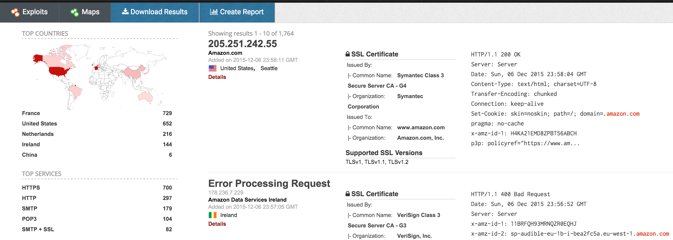
Shodan Delivers Domains
Notes:
You can search for domains, like amazon.com.

Slide 12
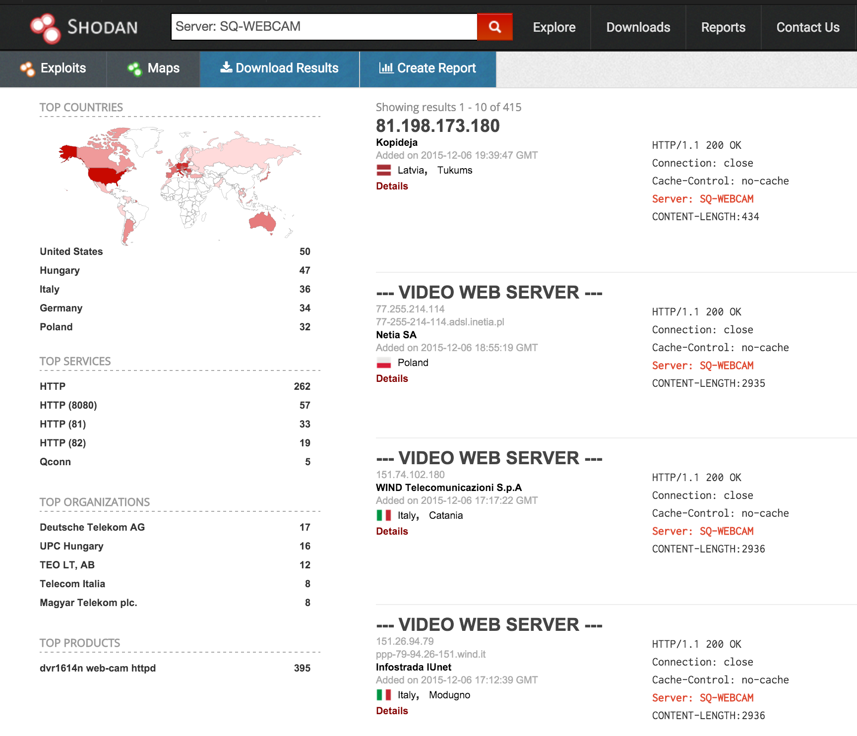
Shodan Delivers Webcams
Notes:
But where Shodan really signs is here, searching for products and services.

Slide 13

Yep, Those Are Webcams
https://www.shodan.io/host/213.168.188.38
Notes:
If you make something available externally, Shodan will find it.

Slide 14
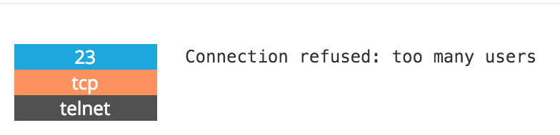
Black Hat Shodan

Slide 15
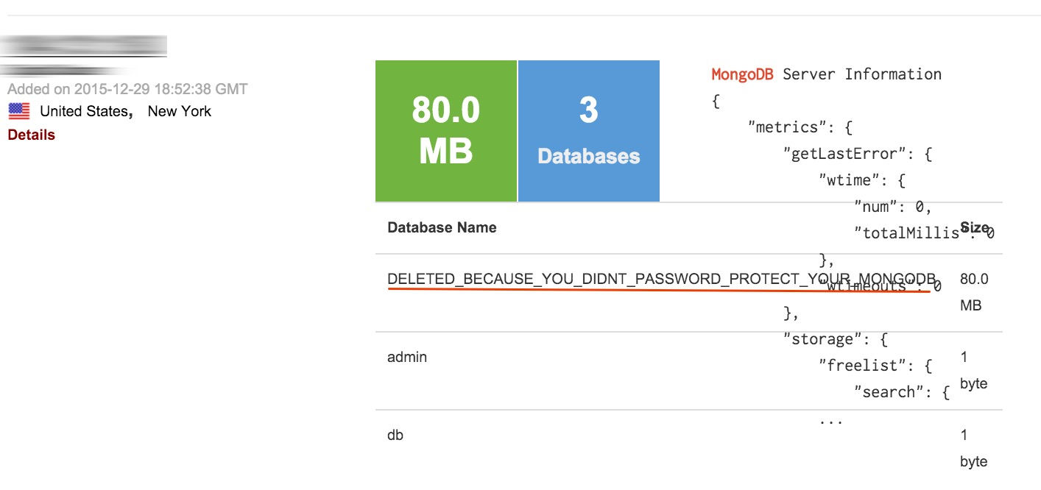
Black Hat Shodan
One of the ~35,000 MongoDB
https://www.shodan.io/host/104.131.18.0
Notes:
This is where it gets nasty.
Latest news regarding the 35,000+ of open MongoDB DBs with 684.8TB
http://www.csoonline.com/article/3016067/security/over-650-terabytes-of-data-up-for-grabs-due-to-publicly-exposed-mongodb-databases.html

Slide 16
Introducing Google Hacking
https://www.exploit-db.com/google-hacking-database/
Google does the hard work, finding and indexing everything publicly available
Google’s search keywords make it easy to filter results to find:
Files and their contents with intext and filetype.
Webcams, routers, and other webpages that can be found by the URL contents with inurl.

Slide 17
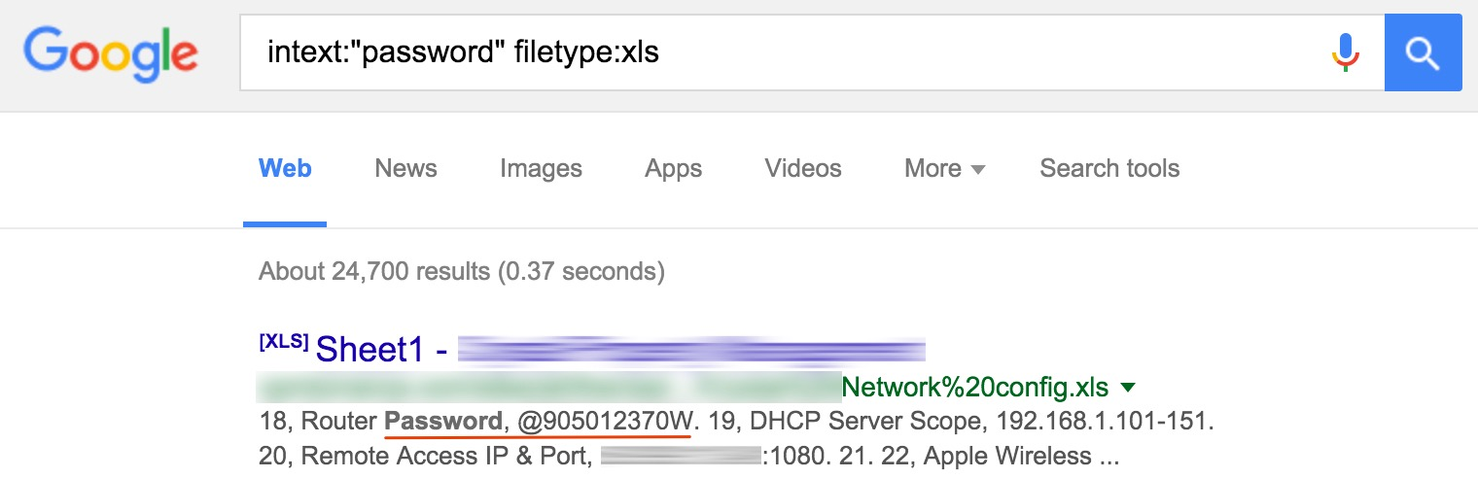
Googling for Passwords, For Real

Slide 18
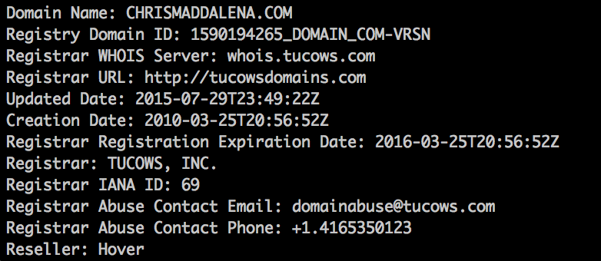
You Don’t Always Need an API
You can learn a lot from an organization without turning to anything like Shodan.
whois
theharvester
Have I Been Pwned

Slide 19
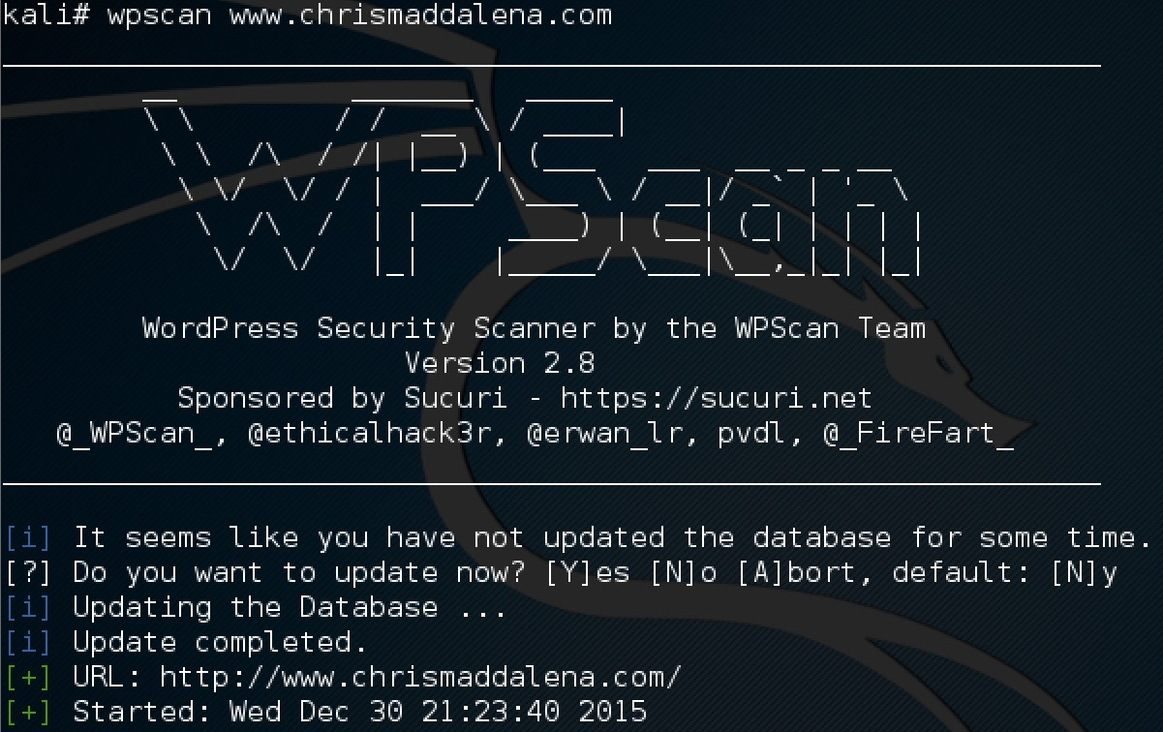
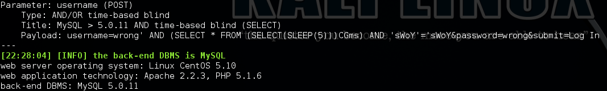
Moving on to Active Scanning
Once you find something of interest, the next step is to take action with active investigation techniques and tools.

Slide 20
DEMO TIME
Kali, theharvester, wpscan, and Nikto

Slide 21
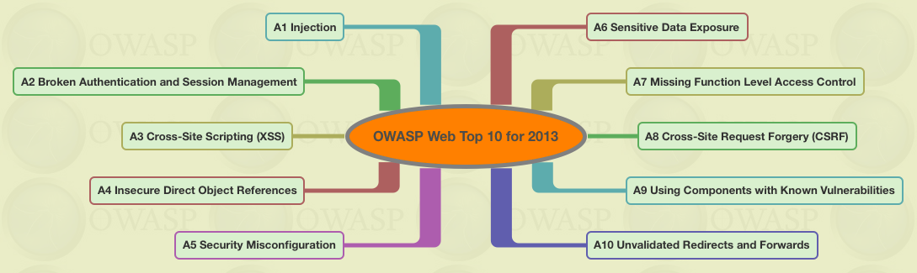
Common Findings: OWASP Top 10
Often discovered during penetration tests…

Slide 22
Common Findings
The OWASP Top 10 are penetration tester favorites.
They are also often targeted for sport and potential profit.
They can appear over time as new issues are discovered in aging versions of platforms and CMSs.
Bug bounty hunters enjoy the $$$ rewards.
Others may simply enjoy finding the problems for mischief.

Slide 23
Why This Matters
It can provide a foothold or access to data.
Possible outcomes to a web app’s compromise during a test:
Manipulation of the app. (ex: Auth Bypass, SQLi)
Access to the server running the app, and the server’s data and files. (ex: LFI)
Control of the server running the app. (ex: RFI)
Malicious outcomes to a compromise:
Compromise of the app’s users. (ex: XSS)
Destruction or manipulation of the app’s data.

Slide 24

Finding These Vulnerabilities
They can be found manually, but this is time consuming.
Manual testing is still important.
Penetration testers use tools to analyze web apps.
Acunetix ($$)
Burp Suite (Free or $)
OWASP ZAP (Free)

Slide 25
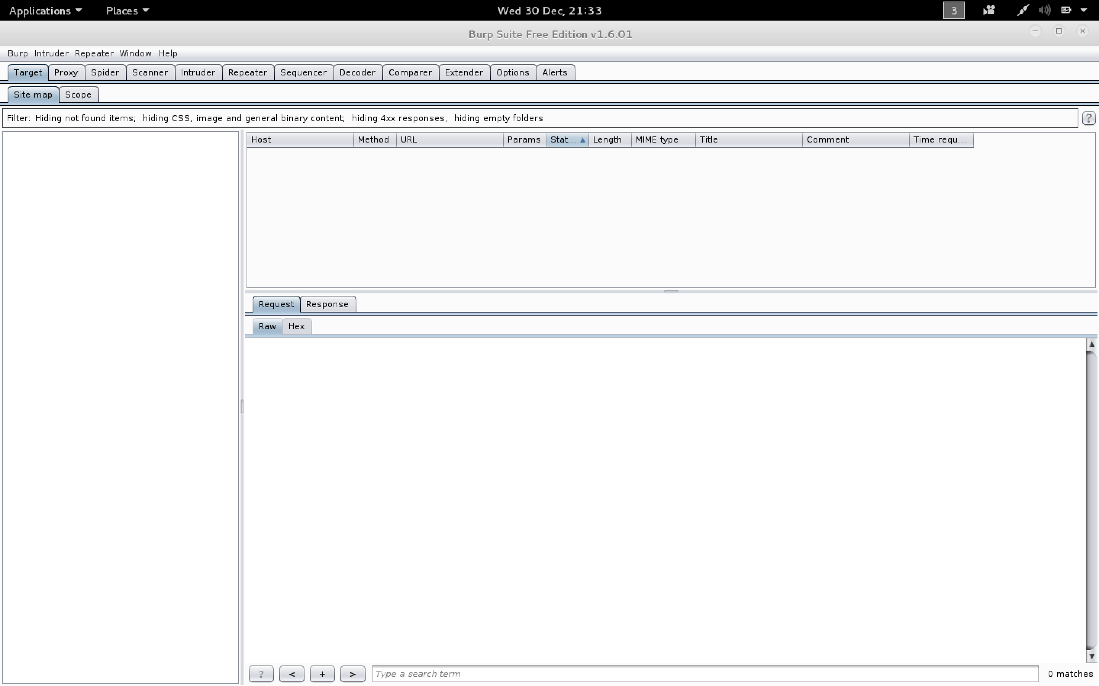
Burp (Excuse me) Proxy
Free to use, only slightly limited.
Full license is $300/year.
It can spider, capture GET/POST, brute force, repeat requests, and more.

Slide 26
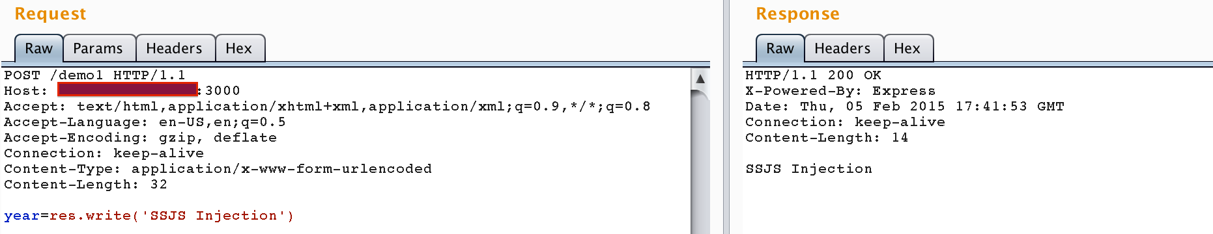
Burp Proxy in Action
Burp can do a LOT, but the proxy is fantastic.
You can capture and review requests!
Here is a Server Side JavaScript exploit example.
Example from s1gnalcha0s on GitHub
Notes:
Server Side JavaScript Injection against Node.js example

Slide 27
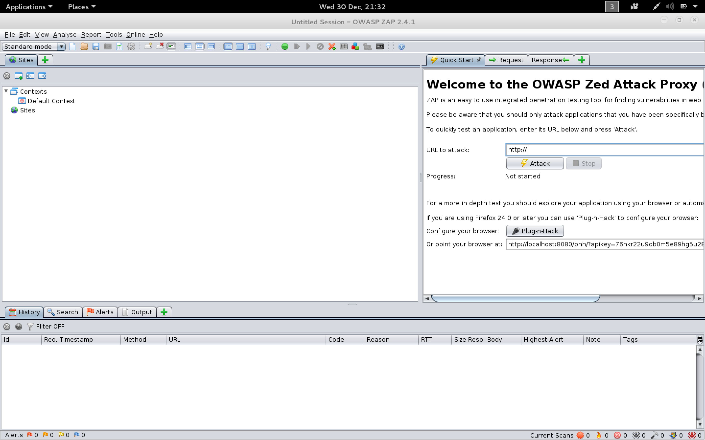
ZAP (Zed Attack Proxy)
Totally free!
As easy as entering a URL to get started.
Runs through a whole battery of tests to find low hanging fruit.
Simple to run during the testing phase, while at lunch, whenever.

Slide 28
Demo Time
Burp, SQLMap, and OWASP ZAP

Slide 29
Applying This Information
Try out ZAP on your own applications.
Consider using it consistently, during testing or as a semi-regular audit tool.
Give Burp a try to see exactly how your apps work.
You can use it on other websites and apps, too!
Be curious and learn.

Slide 30
But Why?
Finding the low hanging fruit will save time later.
Fix it now while the app is in testing.
Avoid a penetration tester finding it later.
ZAP experience may become important to you.
Web app security won’t be going away.
Being able to talk about your experience with it could be beneficial in interviews.
It’s really simple to get started.
Even if you don’t do much more, that’s MUCH better than nothing.

Slide 31
Learning Resources
Local security groups and conferences
#misec
#ohsec
BSides - Great one day conferences.
BSides Indy (March), BSides Cleveland (June), BSides Detroit (July)
CONverge (Detroit, July)
CircleCityCon (Indy, June)
Web Application Hacker’s Handbook
Bug Hunter’s Methodology

Slide 32
Final Thoughts & Questions
Questions?

Slide 33
Thank You!
Chris Maddalena
@cmaddalena

